Slide 1
Data Wrangling Working with Strings
STAT 7500 – Statistical Programming

Slide 2
Overview of Data Wrangling
Isolating data – filter, select, and arrange
Piping operator – %>%
Deriving information – summarize, group_by, mutate
Combining datasets – bind_row and joins
Tidy data – pivot_longer, pivot_wider
Working with strings – stringr
Scraping data – rvest

Slide 3
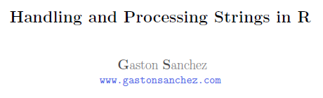
Working with Strings
stringr package (in tidyverse)
www.gastonsanchez.com/Handling_and_Processing_Strings_in_R.pdf

Slide 4
Reading in Character Strings from Files
read_file() reads in the entire file as a single character string
read_lines() creates a vector of character strings, each one from the
file is a separate line

Slide 5

Changing the Case
str_to_lower(x),str_to_upper(x), str_to_title(x) and str_to_sentence(x)
Examples:
str_to_lower(“Villanova”)
str_to_upper(state.name)

Slide 6



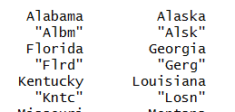
Substrings
str_sub (stringr) or substr (base)
str_sub(string,start,end)
note: negative numbers count from the end
str_sub("Villanova",1,1) # extracts the first value
str_sub("Villanova",6,9) # extracts our nickname
str_sub("Villanova",6) # another version (6 to end)
str_sub("Villanova",-4) # another version (4th from end)
str_sub(state.name,1,3)
Another option:
abbreviate(state.name)

Slide 7
Find Character Strings
str_which(vector, pattern) [base::grep] identifies the indices of matches
str_which(c(“Aardvark”,”Anteater”,”Alligator”),”k”) => 1
str_subset() identifies the values of matches [base::grep(value=T)]
str_subset(c(“Aardvark”,”Anteater”,”Alligator”),”k”) => “Aardvark”
str_detect() produces logical vector instead of count [base::grepl]
Useful for using with mutate or other functions that require vectors
str_detect(c(“Aardvark”,”Anteater”,”Alligator”),”k”) => T F F
Series of characters
You can use “[]” to identify series of characters
You can use “-” within “[]” to identify related characters
str_detect(c(“Aardvark”,”Anteater”,”Alligator”),”[gk]”) => T F T

Slide 8
Find Character Strings II
str_which(state.name,”V”) # lists all states with a V in it
# actually, it lists the index
str_subset(state.name,”V”)
# Hey, what happened to Pennsylvania?
str_subset(str_to_upper(state.name),”V”)
str_subset(state.name,”[Vv]”) # searches for “V” or “v”
Notes:
2nd to last one should be all in caps

Slide 9

Find and Replace
str_replace(string, pattern, replacement) # replaces first occurrence
str_replace_all(string, pattern, replacement) # replaces all occurrences
To remove spaces from state names,
states_nospace <- str_replace_all(state.name, “ “, “”)
Better yet, you can use str_remove_all(state.name,” “) instead…

Slide 10



Counting String Occurrence
str_count(string,pattern)
str_count(“pneumonoultramicroscopicsilicovolcanoconiosis”,”[aeiou]”)
fruit <- c("apple", "banana", "pear", "pineapple")
str_count(fruit, "a")
has_ss <- str_count(str_to_lower(state.name),"ss") # what is this asking for?
state.name[has_ss>0]
state.name[has_ss>1]
str_count(read_file("https://en.wikipedia.org/wiki/Villanova_University"),"Villanova")
The word “Villanova” appears 613 times

Slide 11
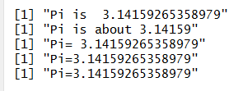

Paste (Concatenate)
paste("Pi is ",pi)
paste("Pi is about",round(pi,5))
paste("Pi=",pi)
paste("Pi=",pi,sep="")
paste0("Pi=",pi) # shortcut for paste with sep=“”
# For different length vectors, you can combine values
paste("MAT",1:5,sep="-")

Slide 12
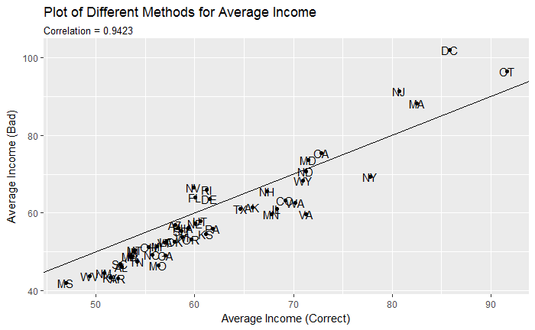
Using Paste in Titles
labs(subtitle=paste("Correlation=",
round(cor(badinc$avginc,badinc$badavginc),4)))

Slide 13
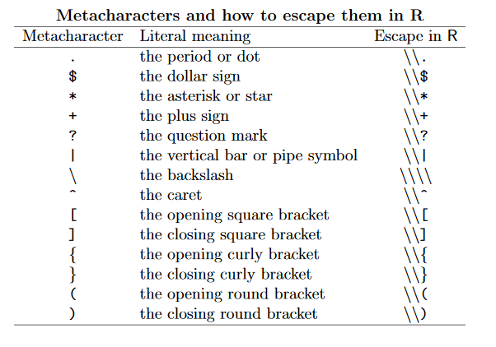
Meta-characters
string <- c("$20.00", "$40")
str_remove_all(string,"$")
“$20.00” “$40”
str_remove_all(string,“\\$")
“20.00” “40”
Notes:
Start here on 10/21/20

Slide 14
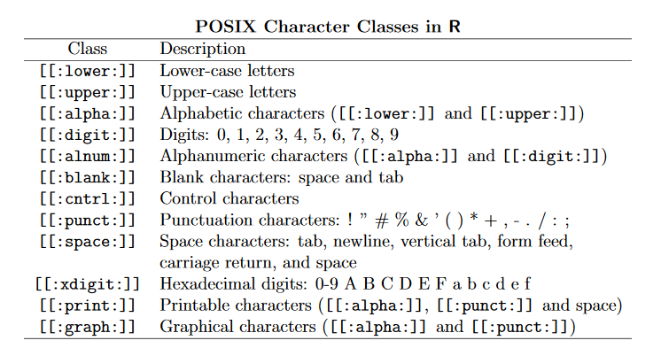
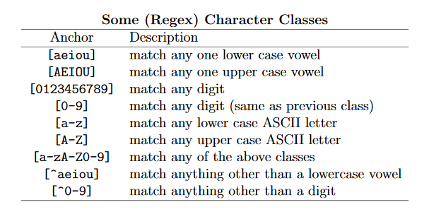
Character Classes
Regular expressions (regex)
Are patterns describing text
^ is a negating qualifier
Notes:
Posix are classes/categories

Slide 15
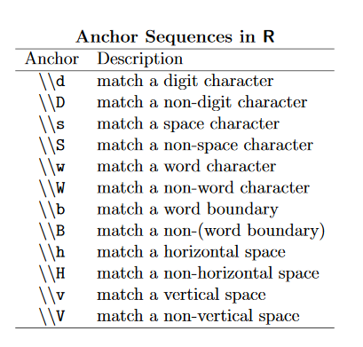
Anchor Sequences
Examples:
str_replace_all("the dandelion war of 2010“, "\\d", "_")
“the dandelion war of ____”
myword <- “t e s t i f y”
print(“Let’s play hangman…”)
str_replace_all(myword,”\\w”,”_”)
Let’s play hangman…
_ _ _ _ _ _ _
(person guesses “t”)
str_replace_all(myword,"[^t\\s]","_")
t _ _ t _ _ _
(person guesses “e”)
str_replace_all(myword,"[^te\\s]","_")
t e _ t _ _ _

Slide 16
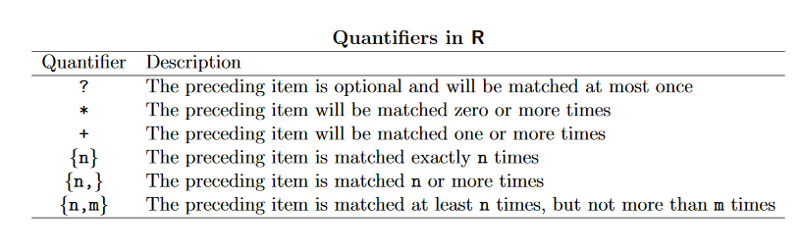
Quantifiers
str_subset(state.name,”e”)
Connecticut Delaware Georgia, etc.
str_subset(state.name,”e{2,}”) # Looks for 2 e’s in a row…
Tennessee

Slide 17
Your Turn
Choose five people’s names and enter them into a vector
Extract the first three characters of each name
Combine the first and last letter of name into a character string (of length 2)
Create two variables
i) the number of vowels in each person’s name
ii) the proportion of vowels in each person’s name
Graph these variables by name
Choose any website and identify the number of times a specific word appears on it [Note – you likely want to save the file as text first]
Use the babynames dataset to…
plot n over time by name for girls whose name starts with “Elizab” but isn’t “Elizabeth”
How many unique names are there that contain the string “liz”
Explore derivations of your own name

Slide 18



Your Turn Solutions
# a
smithposners <- c("Michael","Wendy","Yael","Jonah","Ari")
# b
str_sub(smithposners,1,3)
#c
paste0(str_sub(smithposners,1,1),str_sub(smithposners,-1))
# d
spv0 <- str_count(smithposners,"[aeiou]")
spv <- str_count(str_to_lower(smithposners),"[aeiou]")
spv[spv==0] <- str_count(str_to_lower(smithposners),"y")
sps <- data.frame(names=smithposners, spv)
ggplot(sps) + geom_col(aes(reorder(names,desc(spv)),spv), fill=“blue”)
sps <- mutate(sps, spvp = spv / str_length(names))
ggplot(sps) + geom_col(aes(reorder(names,desc(spvp)),spvp), fill=“blue”)

Slide 19
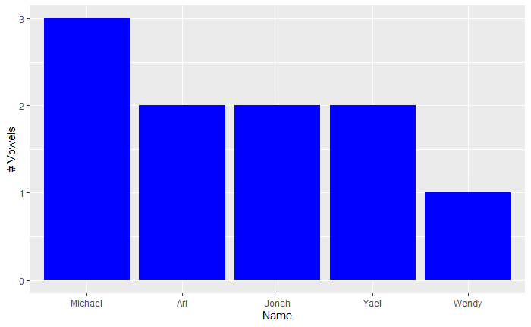
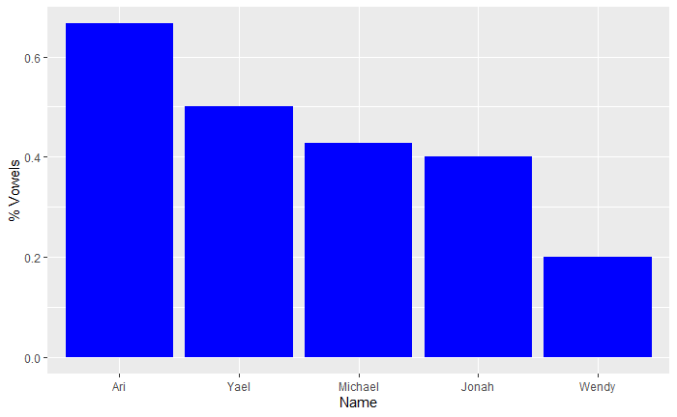
Your Turn Solutions

Slide 20
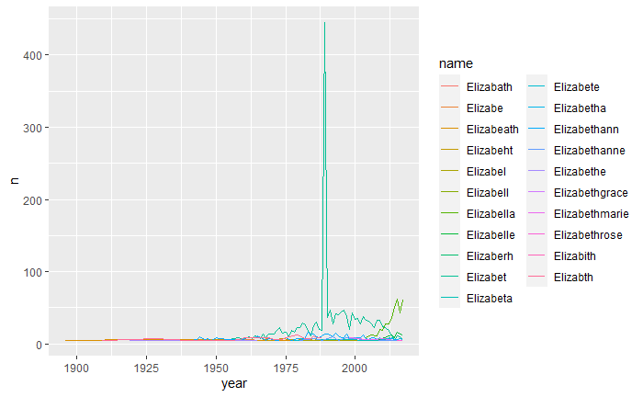
Your Turn - Solutions
babynames %>%
filter(sex=="F",
str_sub(name,1,6)=="Elizab",
name != "Elizabeth") %>%
ggplot() + geom_line(aes(x=year,
y=n,color=name))

Slide 21


Your Turn Solutions
# f ii)
babynames %>%
filter(str_detect(name,"liz")) %>%
count(name) %>%
nrow()
babynames %>%
filter(str_detect(str_to_lower(name),"liz")) %>%
count(name) %>%
nrow()

Slide 22
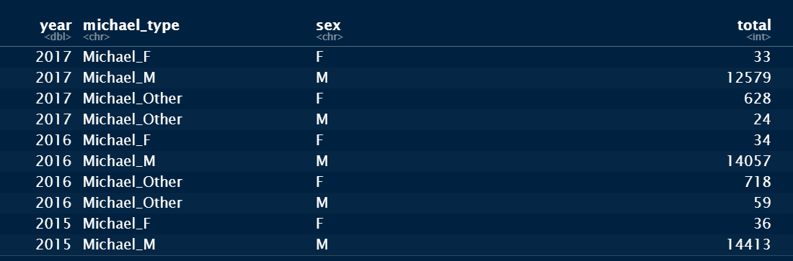
Your Turn - Solutions
# f iii)
babynames %>%
mutate(michael_type = case_when(
name=="Michael" & sex=="M" ~ "Michael_M",
name=="Michael" ~ "Michael_F",
str_sub(name,1,7) == "Michael" ~ "Michael_Other")) %>%
group_by(year, michael_type, sex) %>%
summarize(total = sum(n),
.groups = "drop") %>%
drop_na(michael_type)

Slide 23
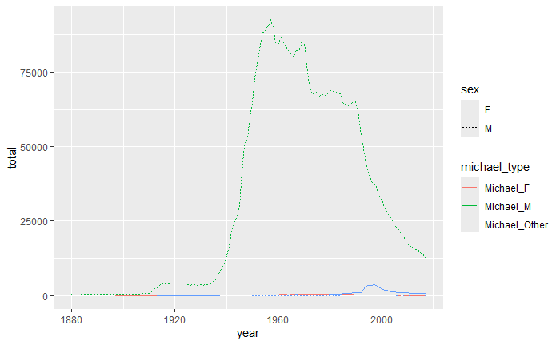
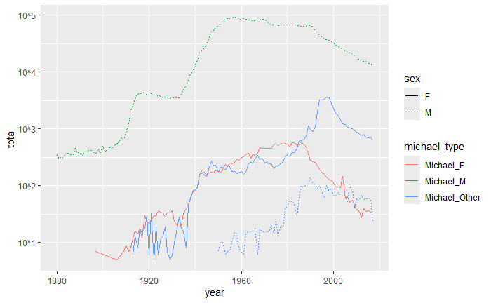
Your Turn - Solutions
# f iii) geom_line(aes(x=year,y=total,lty=sex,color=michael_type))
+ scale_y_log10(breaks = 10^(1:5), labels = paste0("10^",1:5))

Slide 24

Notes:
Start here on 4/1/20

Slide 25
Working with Text
Download Villanova’s Mission Statement text file from website
It matters whether you save it as an html file or text file
Original is at https://www1.villanova.edu/villanova/president/about_university/mission.html
I copied it to Word and saved it as a text file… (with more skill, you can remove all the hypertext codes)
mission <- read_file("Villanova Mission Statement.txt")

Slide 26
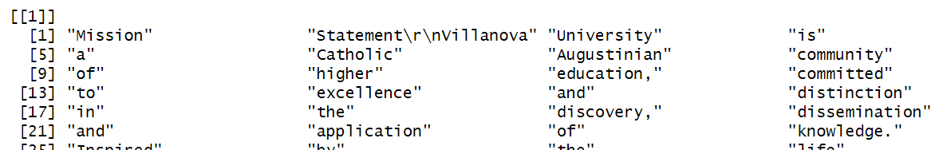
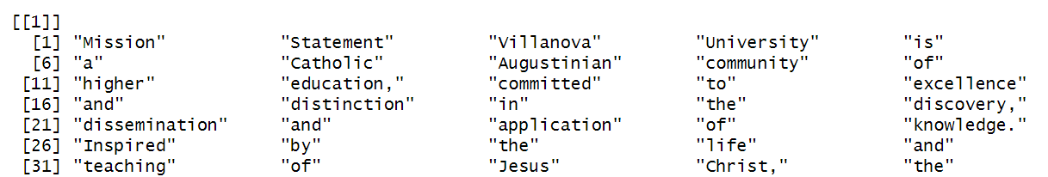
Tokenization (Parsing the File by Word)
mission %>% str_split(" ") # split on each space
mission %>% str_split("\\s+") # split on 1+ space, incl \n and \r

Slide 27
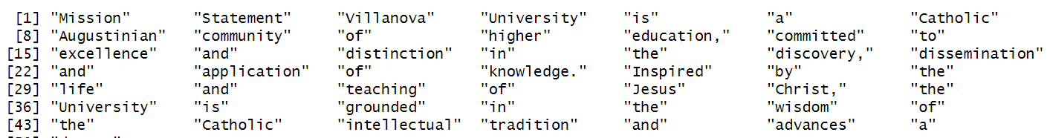
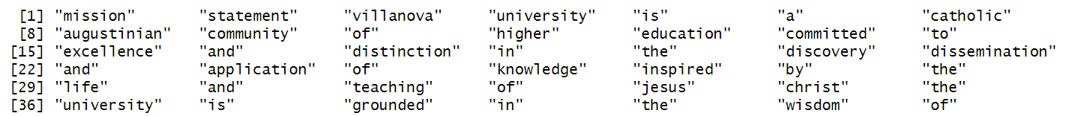
Tokenization II
mission %>% str_split("\\s+") %>% .[[1]] # first item in list
mission %>% str_split("\\s+") %>% unlist() # unlists in data.frame
mission %>% str_remove_all("[[:punct:]]") %>%
str_split("\\s+") %>% unlist() %>% str_to_lower()

Slide 28


Tokenization III
missionwords <- mission %>%
str_remove_all("[[:punct:]]") %>% # remove punctuation*
str_split("\\s+") %>% # splits on spaces +
unlist() %>% # make into data.frame
str_to_lower() %>% # makes lower case
data.frame(words=.) # add this to make data.frame
* different result if you put this before unlist. Why?
missionwords %>% nrow()
missionwords %>% n_distinct(words)
Technically, “tokenizing” then assigns each word to a number

Slide 29
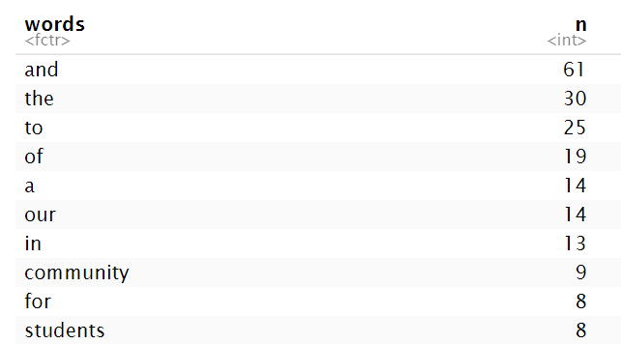
Word Totals
missionwords %>%
count(words) %>%
arrange(desc(n))

Slide 30
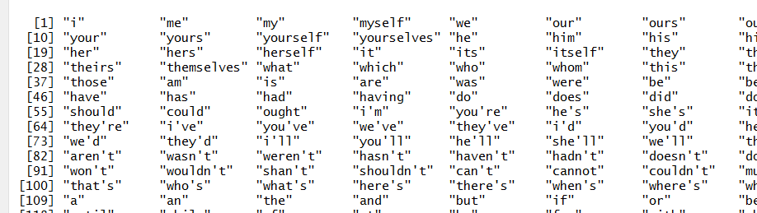
Stopwords
library(tm)
stopwords("english")

Slide 31
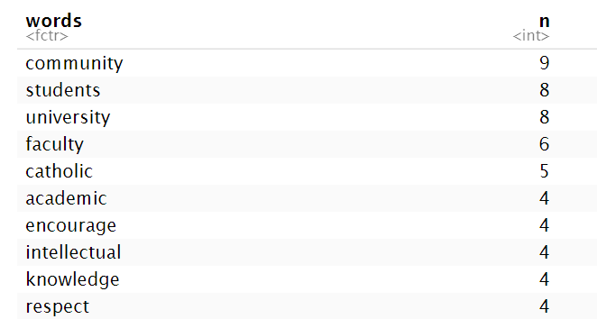
Remove Stopwords
missionwords %>%
filter(words %in% stopwords("english") == F) %>%
count(words) %>%
arrange(desc(n))

Slide 32
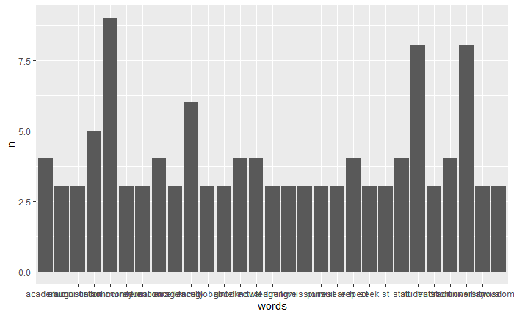
Graph of Mission Statement Words
missionwords %>%
filter(words %in% stopwords("english") == F) %>%
count(words) %>%
arrange(desc(n)) %>%
filter(n>=3) %>%
ggplot() +
geom_col(aes(words,n))

Slide 33
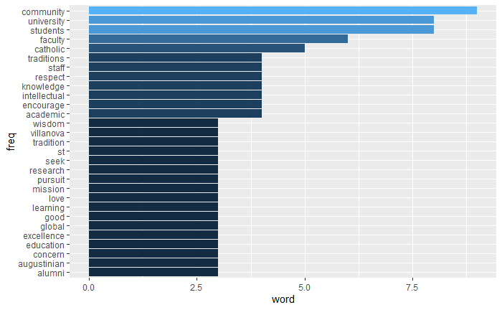
Graph of Mission Statement Words II
missionwords %>%
filter(words %in% stopwords("english") == F) %>%
count(words) %>%
arrange(desc(n)) %>%
filter(n>=3) %>%
ggplot() +
geom_col(aes(reorder(words,n),
n,fill=n)) +
coord_flip() +
labs(y="word", x="freq") +
guides(fill=F)
Notes:
Axis labels are reversed, change yaxis labels to whole numbers

Slide 34


Wordcloud
There’s a package for that…
wordcloud(missionwords$words)

Slide 35

Wordcloud II
wordcloud(missionwords$words,
min.freq=4, colors=1:4, random.order=F)

Slide 36
Additional Topics in Text Mining
Emotion and Sentiment Classification
Natural Language Processing (NLP)
Corpora – see tm package
Statistics for Text Mining

Slide 37

Practice with Text
The gutenbergr package links to data from the Gutenberg Project
Choose a topic to explore
Create an indicator variable if it is mentioned in the title
Explore it further…

Slide 38
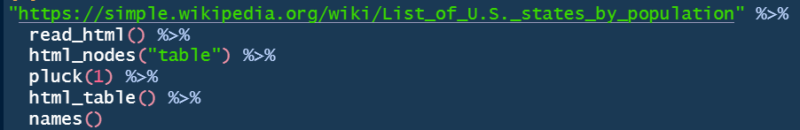
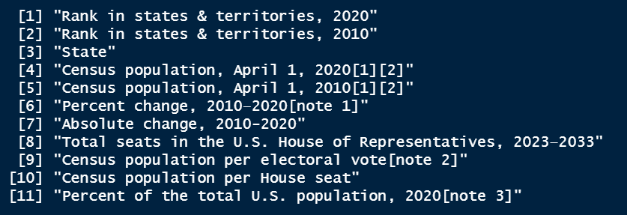
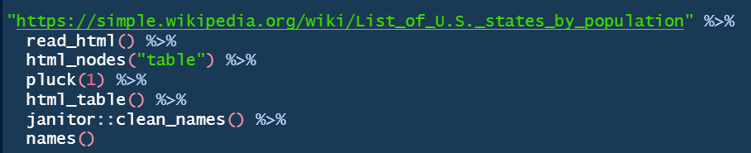
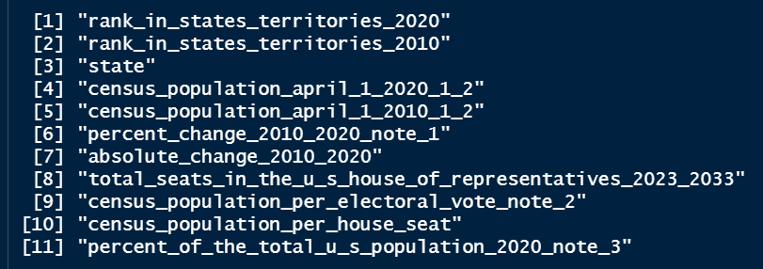
janitor::clean_names()
Changes all variable names to valid R names with common format

Slide 39
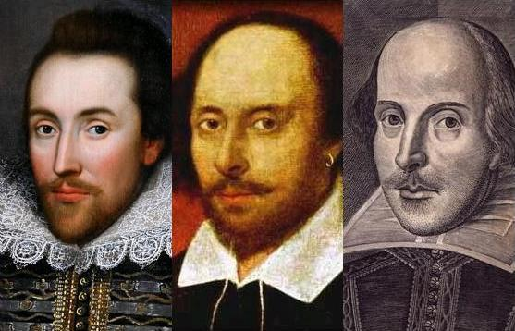
On Shakespeare We Count
This Photo by Unknown Author is licensed under CC BY-SA

